Slide 1
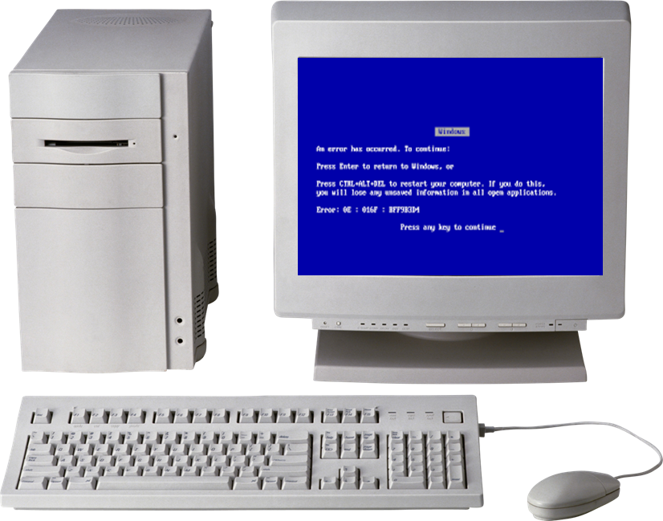
Introduction to Computing
[Brian]
[Henry]
[Wayne]
[Haneef]
[Pandeli]

Slide 2
Four mini demos + Meet the team
Introduction:
MP1 Computing: Wayne + Haneef
MP2 Software Development: Henry
MP3 Networking: Pandeli
MP4 Cyber-Security: Brian
Reflection and GA:I Team Task
Conclusion: Team Task

Slide 3
MP1: Computing
The problem : The clients were northwest architecture LTD and they needed new PC'S for 4 different roles but they need to be built specifically to match the roles and different use each staff will have for each PC. Each PC needs to meet the employee's requirements and provide suitable performance whilst still being within the budget of the company.
PC architecture :
Administrative Assistant- Henry and Wayne
We focused on building affordable and reliable computers that would still be more than capable of handling your everyday tasks such as, emails, microsoft word, excel, and just managing documents in general. This role didn’t really require powerful processors or expensive graphic cards which helped to keep costs down.
SQL database : click here

Slide 4
MP1: Computing p2
CAD Architect / Designer- Brian
These builds tend to need more powerful processors, reliable RAM and suitable graphics cards to handle the software, this would allow employees to be able to create detailed drawings without experiencing any slowness.
Project Manager- Pandeli
Now these computers need to be able to handle multitasking, project planning and communication, on this we focused on reliable processors, enough RAM and also fast storage so that project managers would be able to use spreadsheets with no hassle, planning software and other apps at the same time.

Slide 5
3D Visualisation Specialist- Haneef
These builds require the highest performance graphically because employees would potentially be working with difficult 3D models, rendering and visualising software. Powerful graphics cards, processors and enough RAM was important to be able to ensure demanding tasks can be completed to a high standard.
One Decision
For the administrative build we had personally decided to make It cost effective rather than proper high performative alternatives as it only has simple tasks to complete in comparison to the other roles and also mainly because this only needed to be able to do office basic roles.
The final build for this was £889.64 which was way under budget while still providing more than enough performance for the role

Slide 6
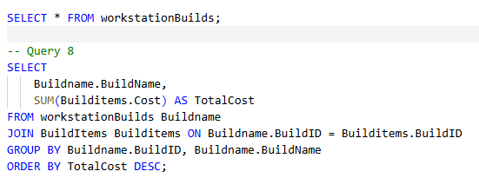
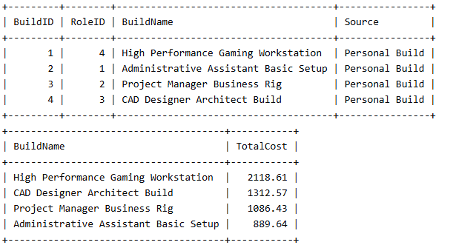
Mini demo: query live data
Open SQL database here
Run One SELECT query, short enough to explain
Show Real, correct rows. Point at one result.

Slide 7
MP2: Software Engineering
The problem: Pennine Pizza Works wants a simple computer program that can calculate customer orders more accurately. The team has been asked to design, build and test a program for them that can handle customer orders, Specifically these were their requirements for the program:
Produce a personalized + itemized bill for the customer
              Customer details – Cost of each pizza – Total Cost – if Discount/delivery applied
              Allow choice of extra toppings and size
              Apply discount + delivery charge

Slide 8
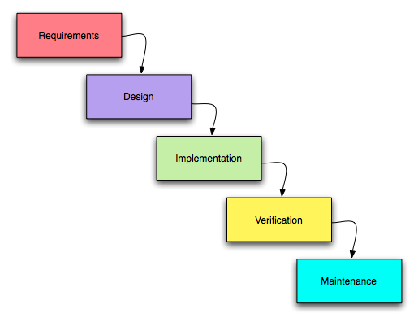
How we worked
The team was split up into completing 5 individual tasks following the waterfall software development life cycle, this was how the workflow was segmented:
Analysis – Wayne + Pandeli
Design – Brain
Build – Henry
Testing – Haneef

Slide 9
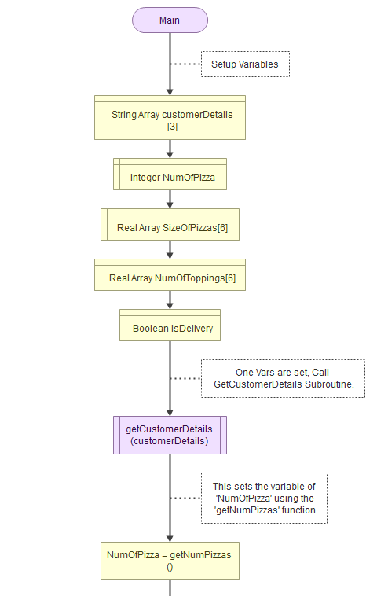
Our solution: Our solution was done in Flowgorithm, and we expanded on the original task set for us in these areas where they were not otherwise specified:
Include discount amount
Error Handling (stringChecker)
Store most info as arrays
No maximum amount of toppings
Our solution was developed with good programmer practices in mind e.g. reusing functions for separate tasks.

Slide 10
Mini demo: run the program
Open this link ☺
Run Showing typical order as test input, then show error handling
Show Output + edge case scenario

Slide 11
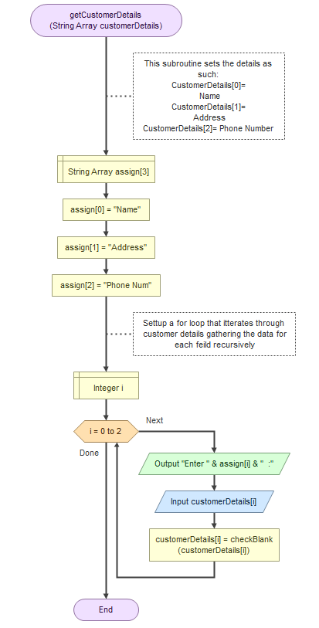

Slide 12
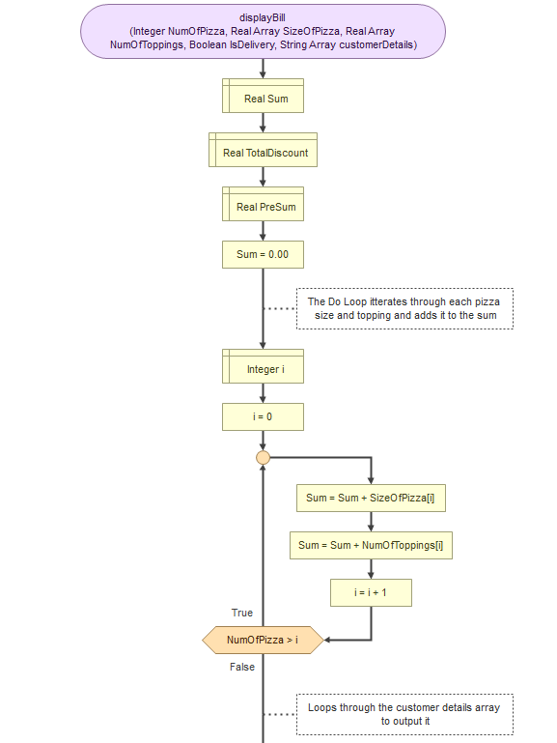
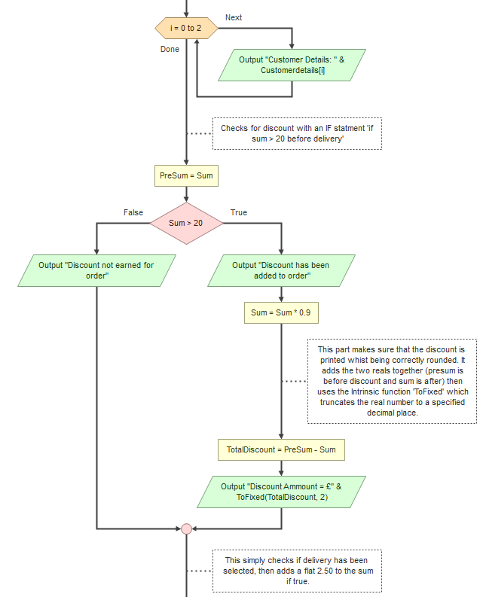
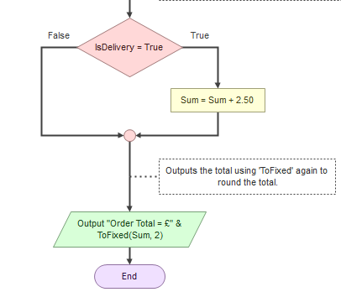

Slide 13
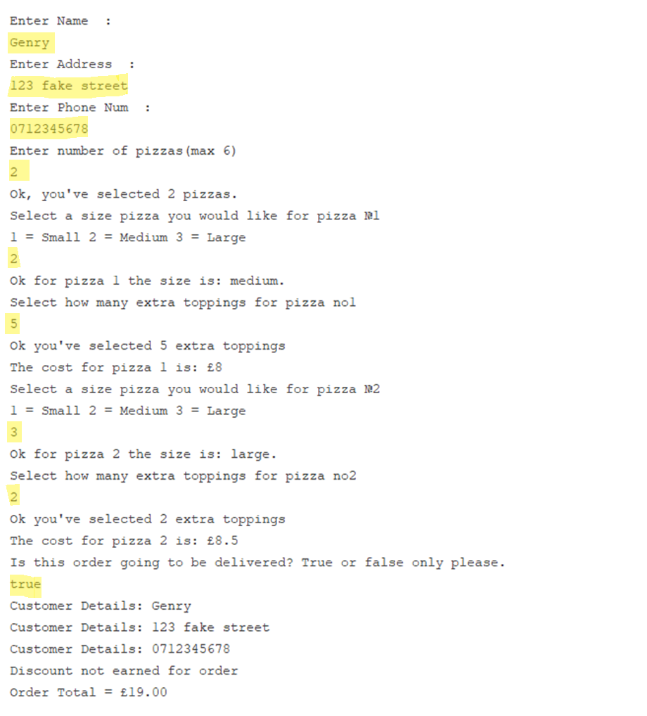
Example Results
User input is specified by highlighted yellow text

Slide 14
MP3: Networking
The problem We were tasked to design and simulate a working office network for NorthWest Architecture Studio Ltd using Filius software.
Our solution Each team member created a design and have attached screenshot evidence on our report from their builds with all the testing
One decision We had to make a report showing the topology we were tasked to create,screenshots were attached showing successful pings between different devices in the network,test DNS, webservers and also explain at least 5 protocols and concepts from the table we were given

Slide 15
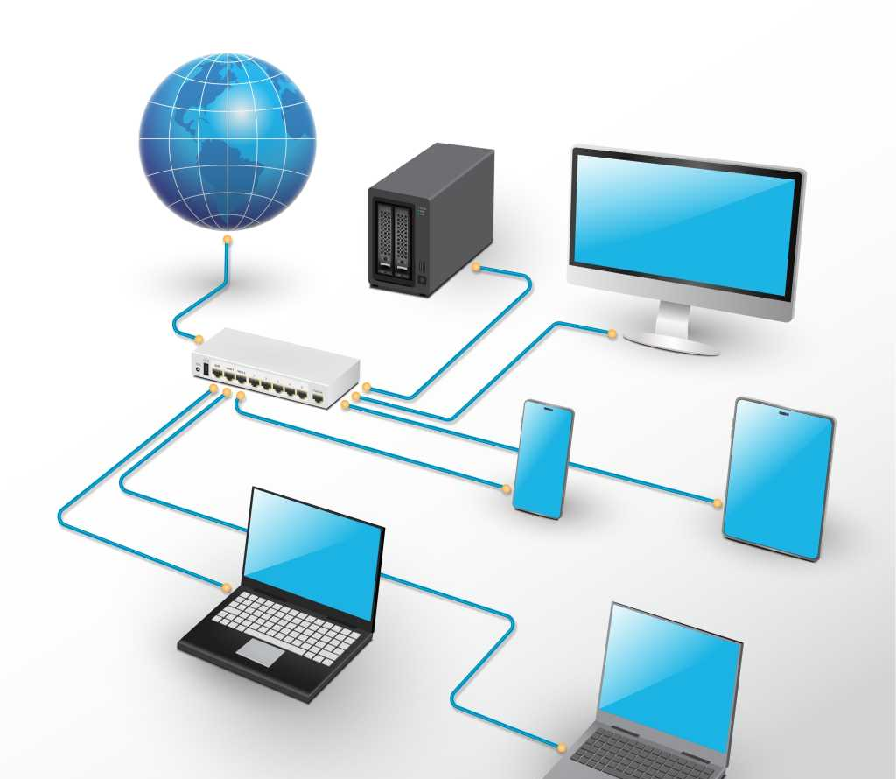
Mini demo: ping the network
Our filius file [here]
Run A ping or browser request: from which machine to which
Show A successful reply across the network

Slide 16
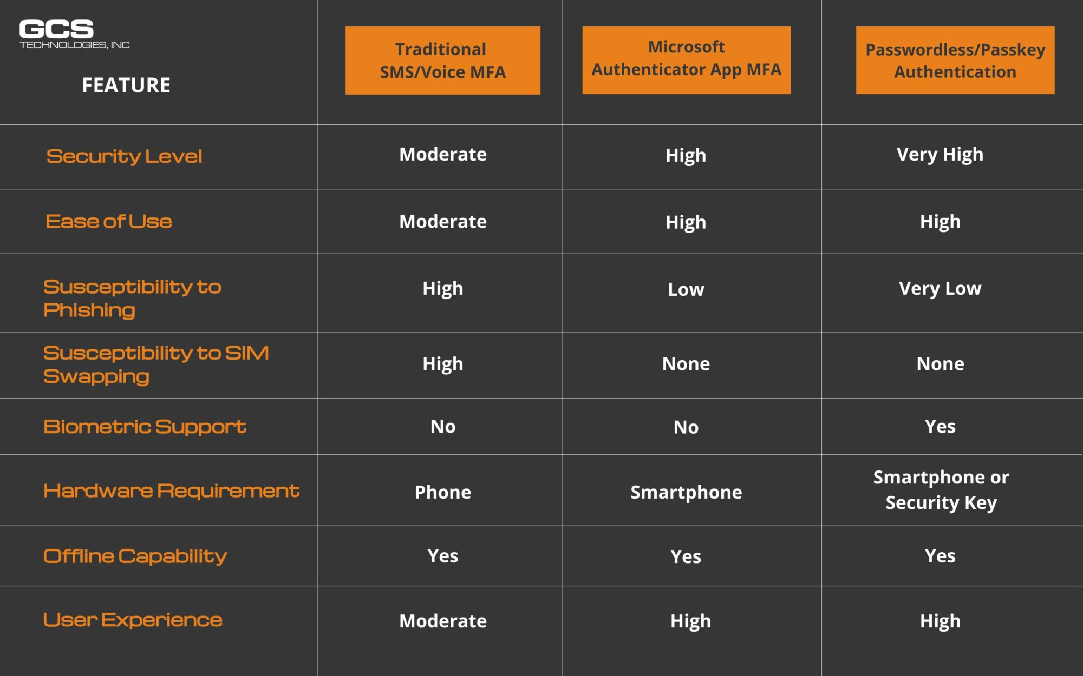
MP4: Cyber Security
The problem create a research paper about Cyber security
Our solution Each person research a criteria of Cyber Security create a report providing references
One decision Who researches which criteria of cyber security
Notes:
The problem We were tasked with creating a research paper about Cyber security
Our solution Each person was tasked with researching a certain criteria of Cyber Security and creating a 1000-word report providing references
One decision We had to make a report about Password hygiene, MFA, Phishing, Safe use of devices and Safe use of public WI-FI, each

Slide 17
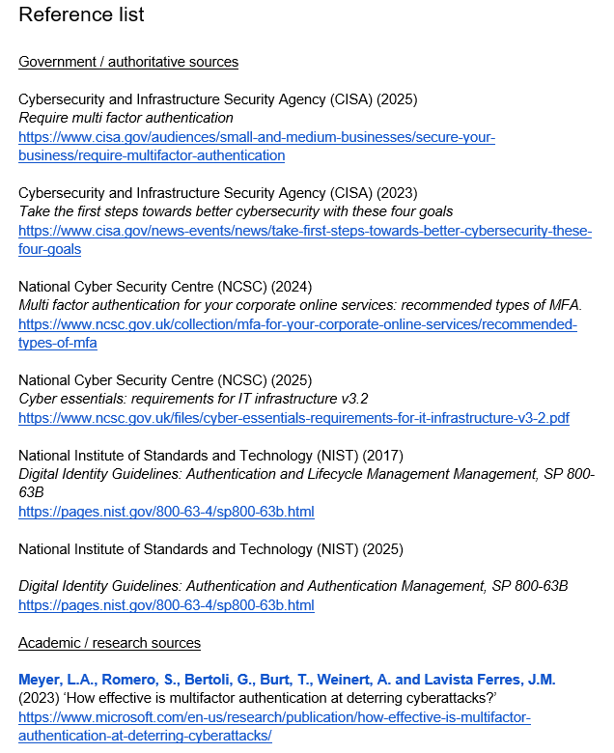
Mini demo: MFA
Link Sample of Cyber Security document
Point I decided to use my part of the research paper since it is the part of our research paper, I'm most familiar with

Slide 18
What links the four projects
How they connect All these mini projects connect different essential and important aspects of computing
What went well We were quick when it came to getting the work done
What was hard or unfinished I challenge we faced was communication
What we learned working as a team is essential with project work and communication is important
Notes:
How they connect All these mini projects connect different essential and important aspects of computing
What went well We were quick when it came to getting the work done
What was hard or unfinished I challenge we faced was communication, we had quiet a few problems with getting in touch with a few of our team members which caused a few issues
What we learned working as a team is essential with project work and communication is important

Slide 19
How we used and checked GAI
MP1 Not used→ No Ai was used or needed to be used for the builds, nor the complete database.
MP2 Not used at all → No Ai was used to create or help the creation of the Flowgorithm application nor the document.
MP3 Not used at all → No Ai was used to create the networks
MP4 Not / partly used → during our research we avoided using AI, but some members used AI when gathering their data since we saw errors in their referencing
Notes:
MP1
MP2
MP3
MP4: we didn't use any AI when doing our cyber security research, this is because we needed to source all of our information and I dont think AI can reliably source totally accurate / reliable information since it the client brief specifically asked to use Harvard referencing and to also

Slide 20
Conclusion and questions ?
Takeaway overall, we as a team believe that we could have communicated as a team better, and motivated each other to push through with doing our work on time efficiently
Q&A does anyone have questions
Notes:
Communication between was poor, for example haneef struggled to do his allocated work multiple times and didn't inform any of the team
evidencing could of been done a lot better, the github repository could of been used a lot better and wasn't utilised as well as it could of been

